Slide 1

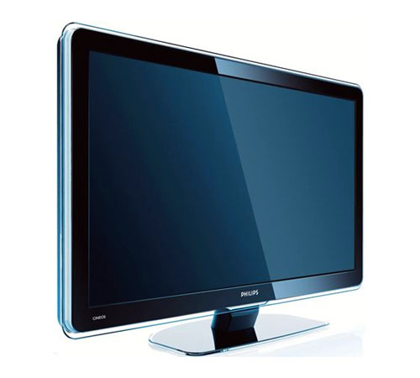
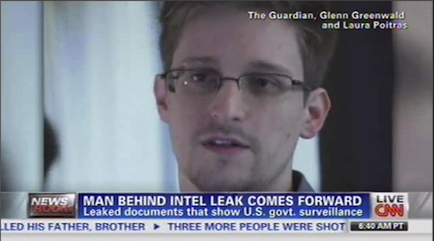


Contextualizing Events in TV News Shows
José Luis Redondo García, Laurens De Vocht, Raphaël Troncy,
Erik Mannens, Rik Van de Walle
{redondo, raphael.troncy}@eurecom.fr
{laurens.devocht, erik.mannens, rik.vandewalle}@ugent.be

Slide 2
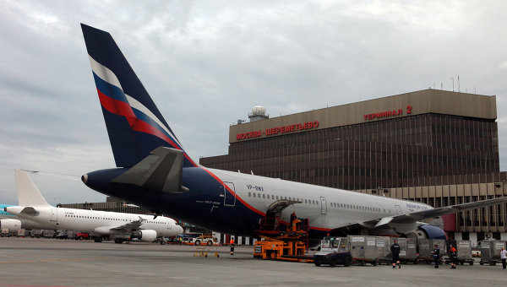
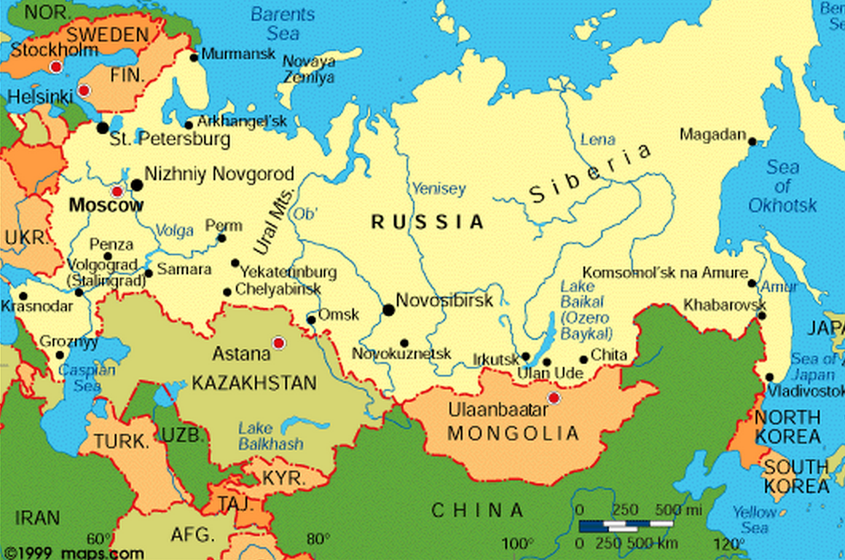
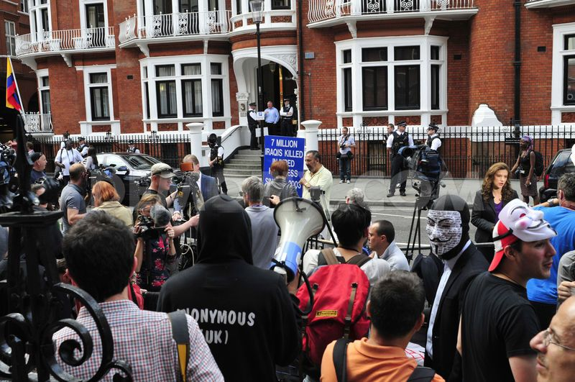
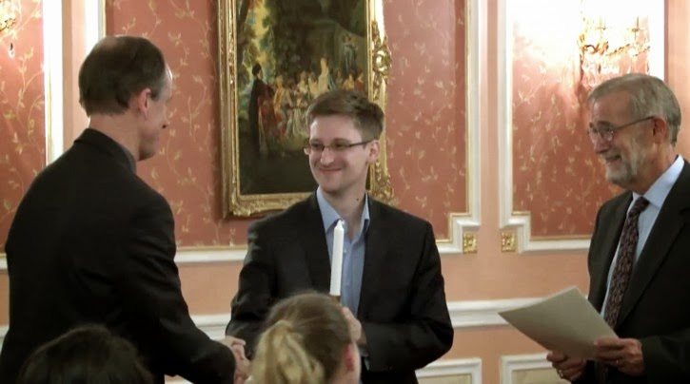
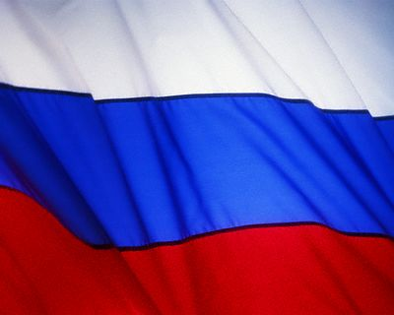


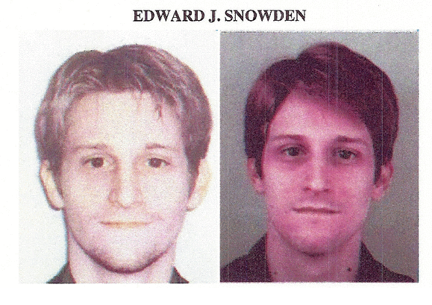
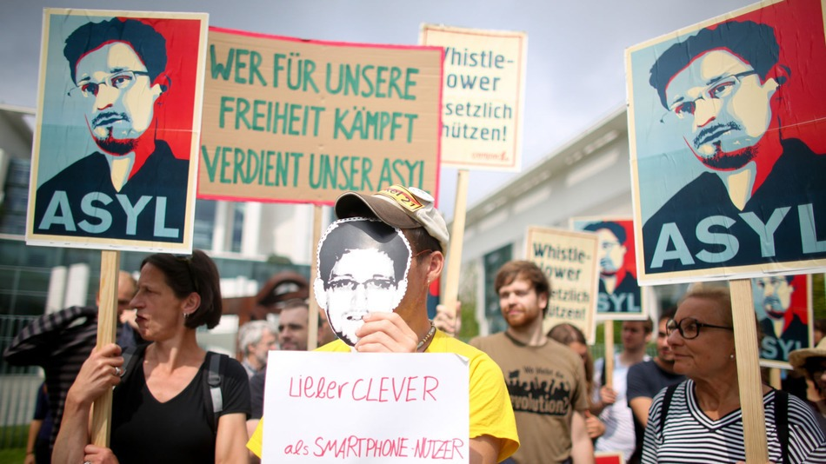
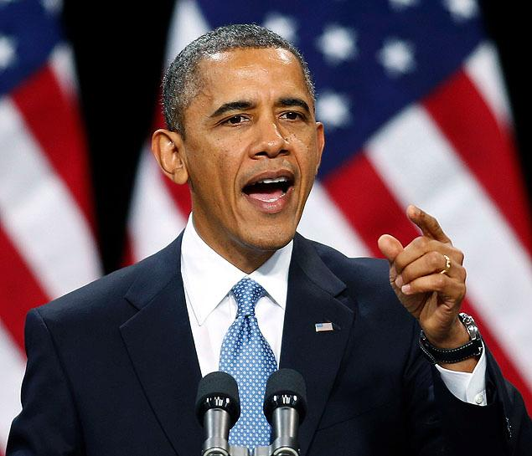
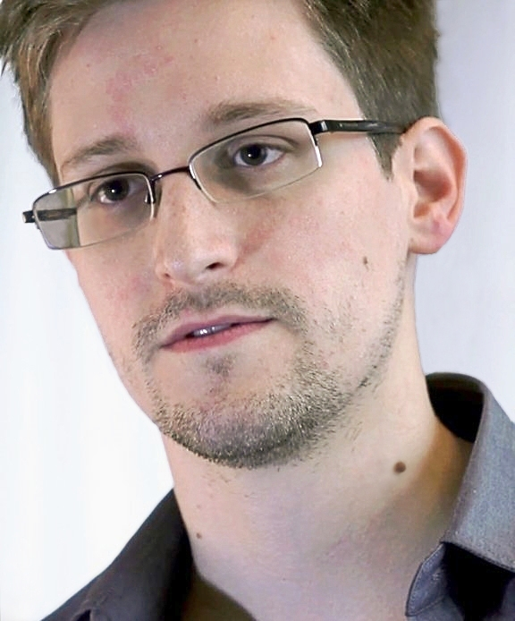
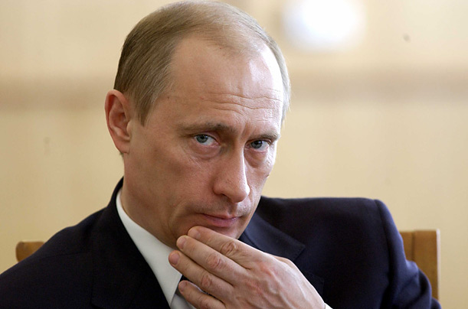
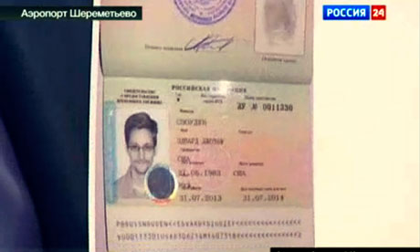

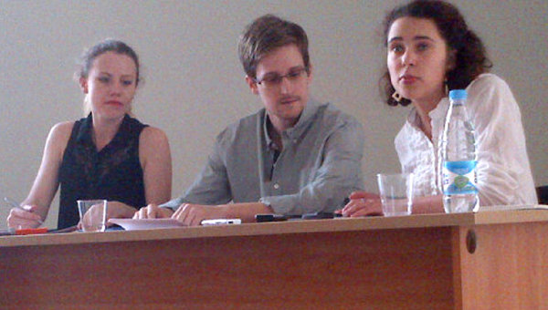
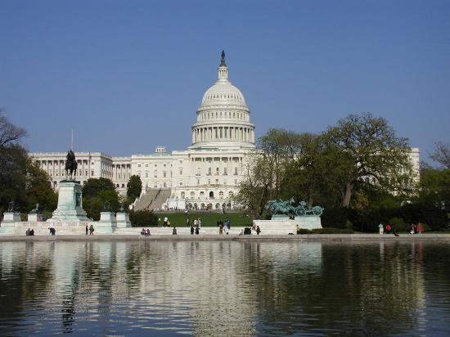
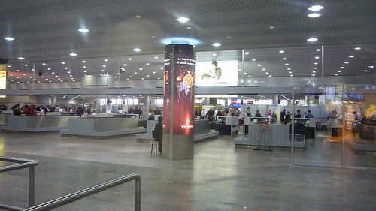

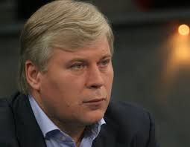



The Problem: User Perspective
Edward Snowden Ask for Asylum In Russia (04 / 07 /2013)
2

Slide 3
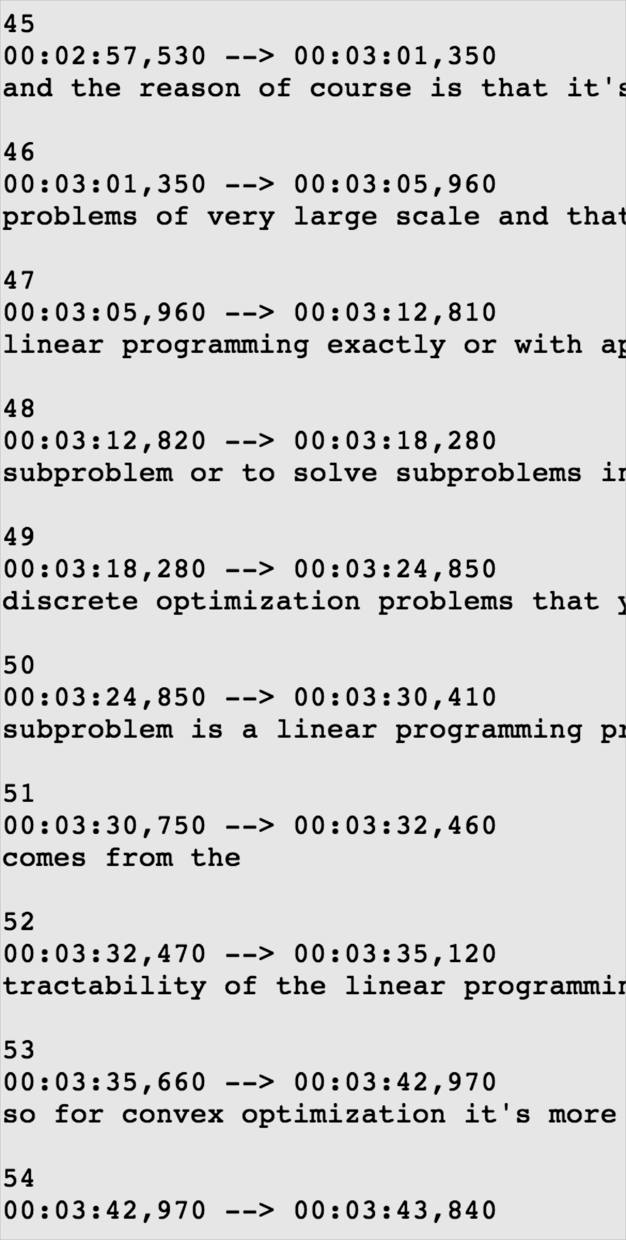
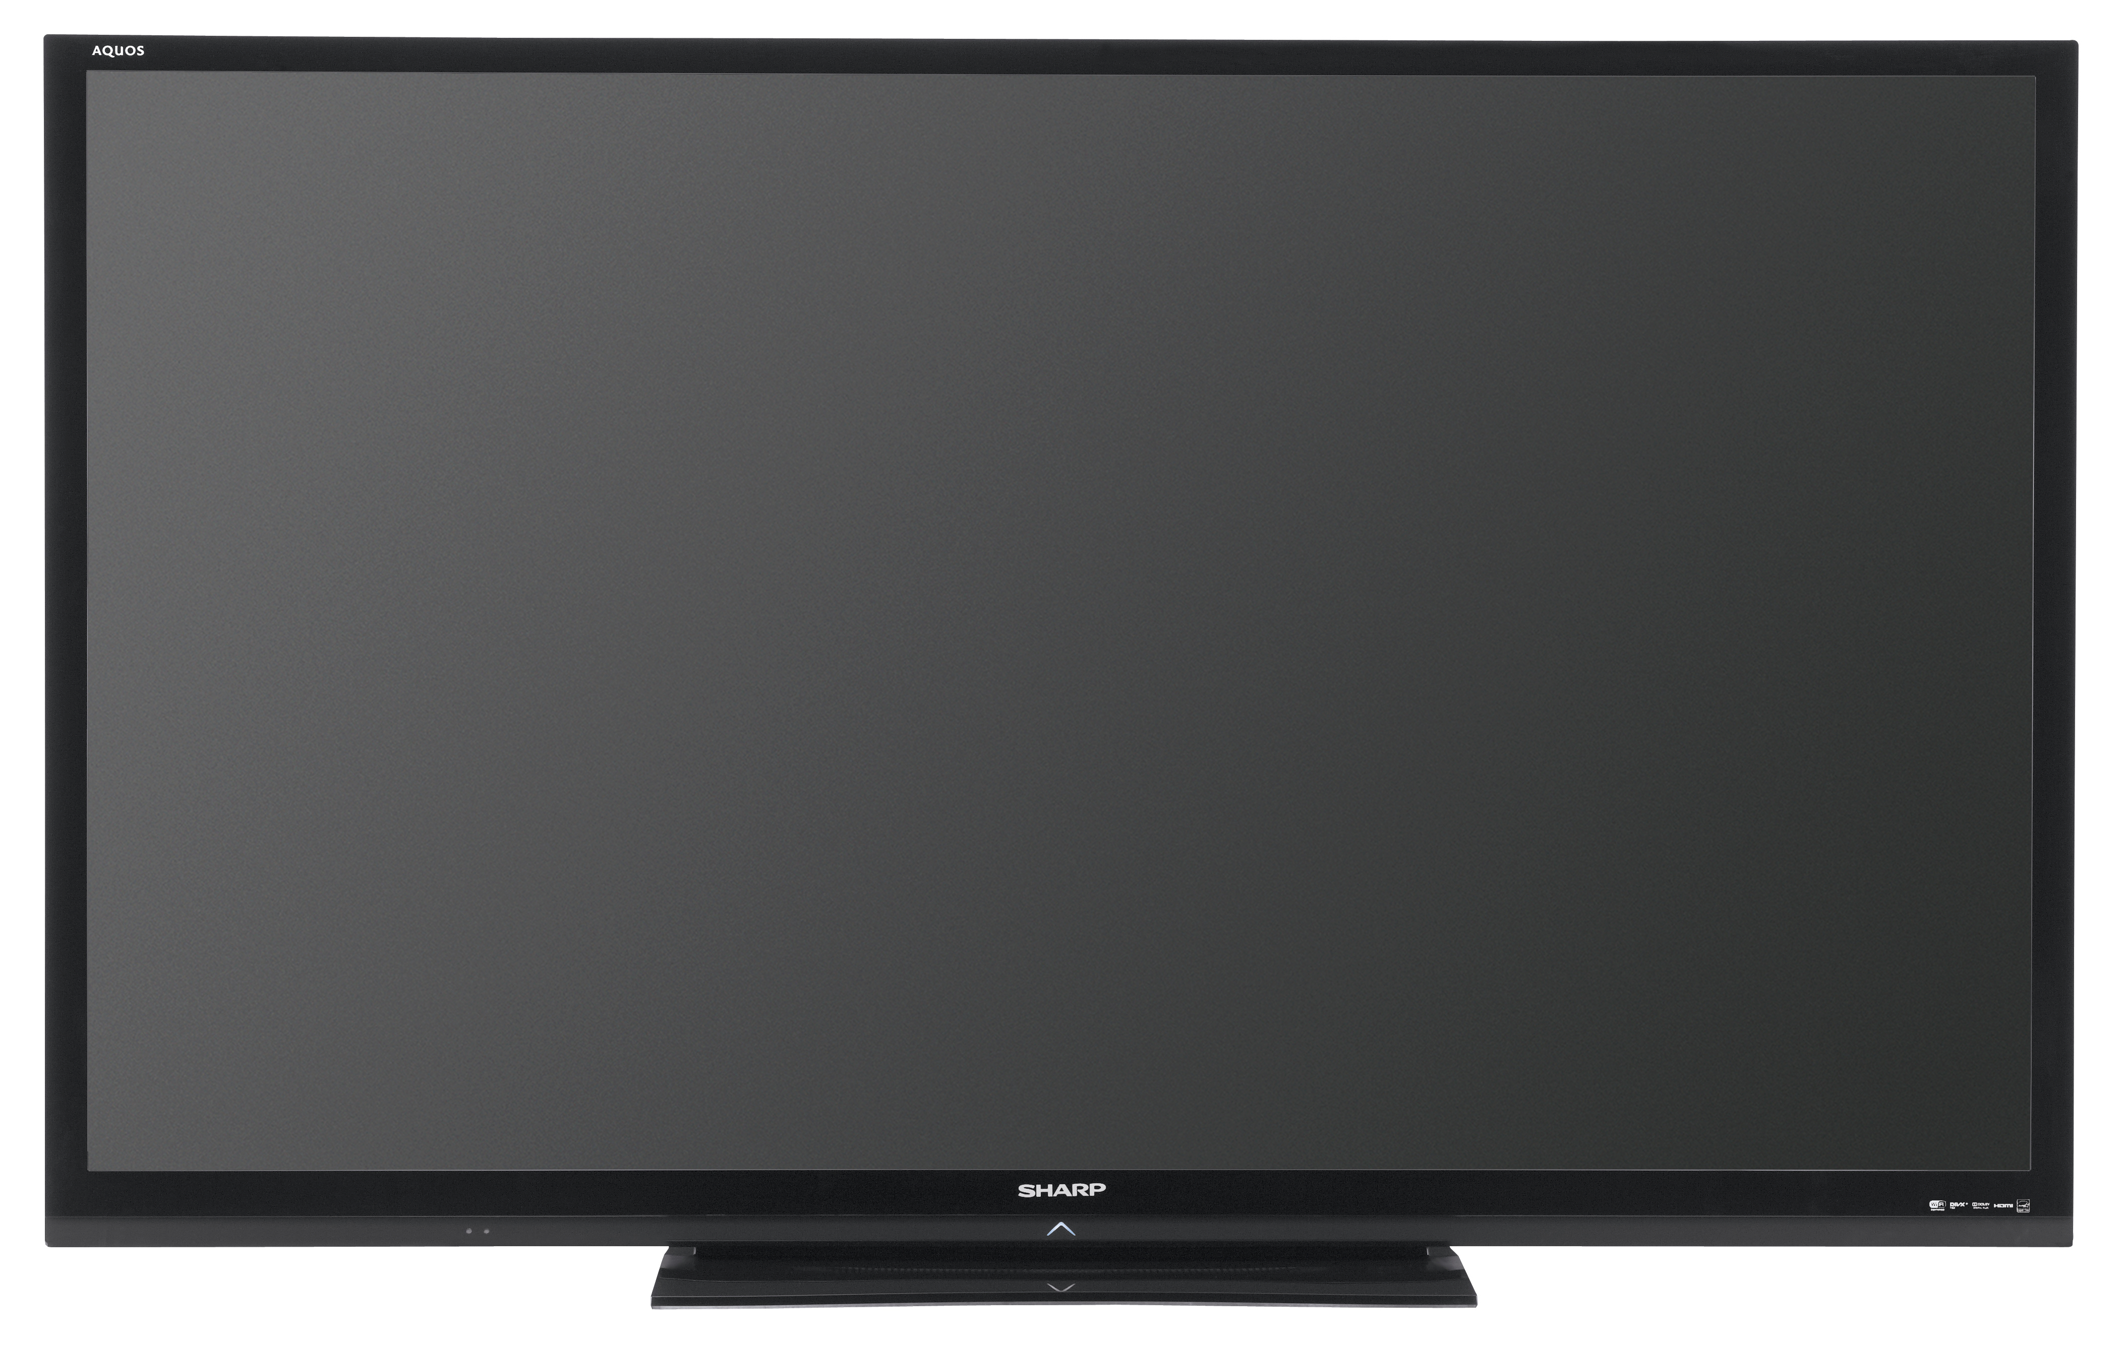
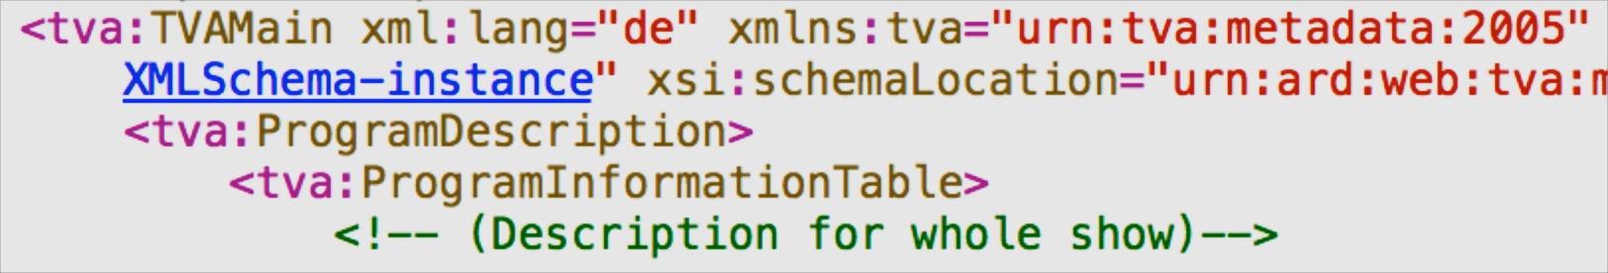


The Problem: Technological Perspective
In which russian airport is he exactly?
Solution: go out and grab it!
??
Subtitles
Metadata
OCR
Visual Cues
LSCOM:Face
LSCOM:Building
3

Slide 4
The Approach
a) Entities from Video
e_{a}
e_{b}
e_{c}
e_{d}
Event Context:
List of Relevant Named Entities
(1) Named Entity Expansion
b) Expanded Entities
e_{a}
e_{b}
e_{c}
e_{d}
e_{f}
e_{g}
e_{h}
e_{i}
e_{j}
e_{k}
e_{l}
e_{m}
(2) DBpedia Filtering and Ranking
b) Re-ranked Entities
e_{a}
e_{c}
e_{h}
e_{j}
e_{k}
e_{m}
4

Slide 5
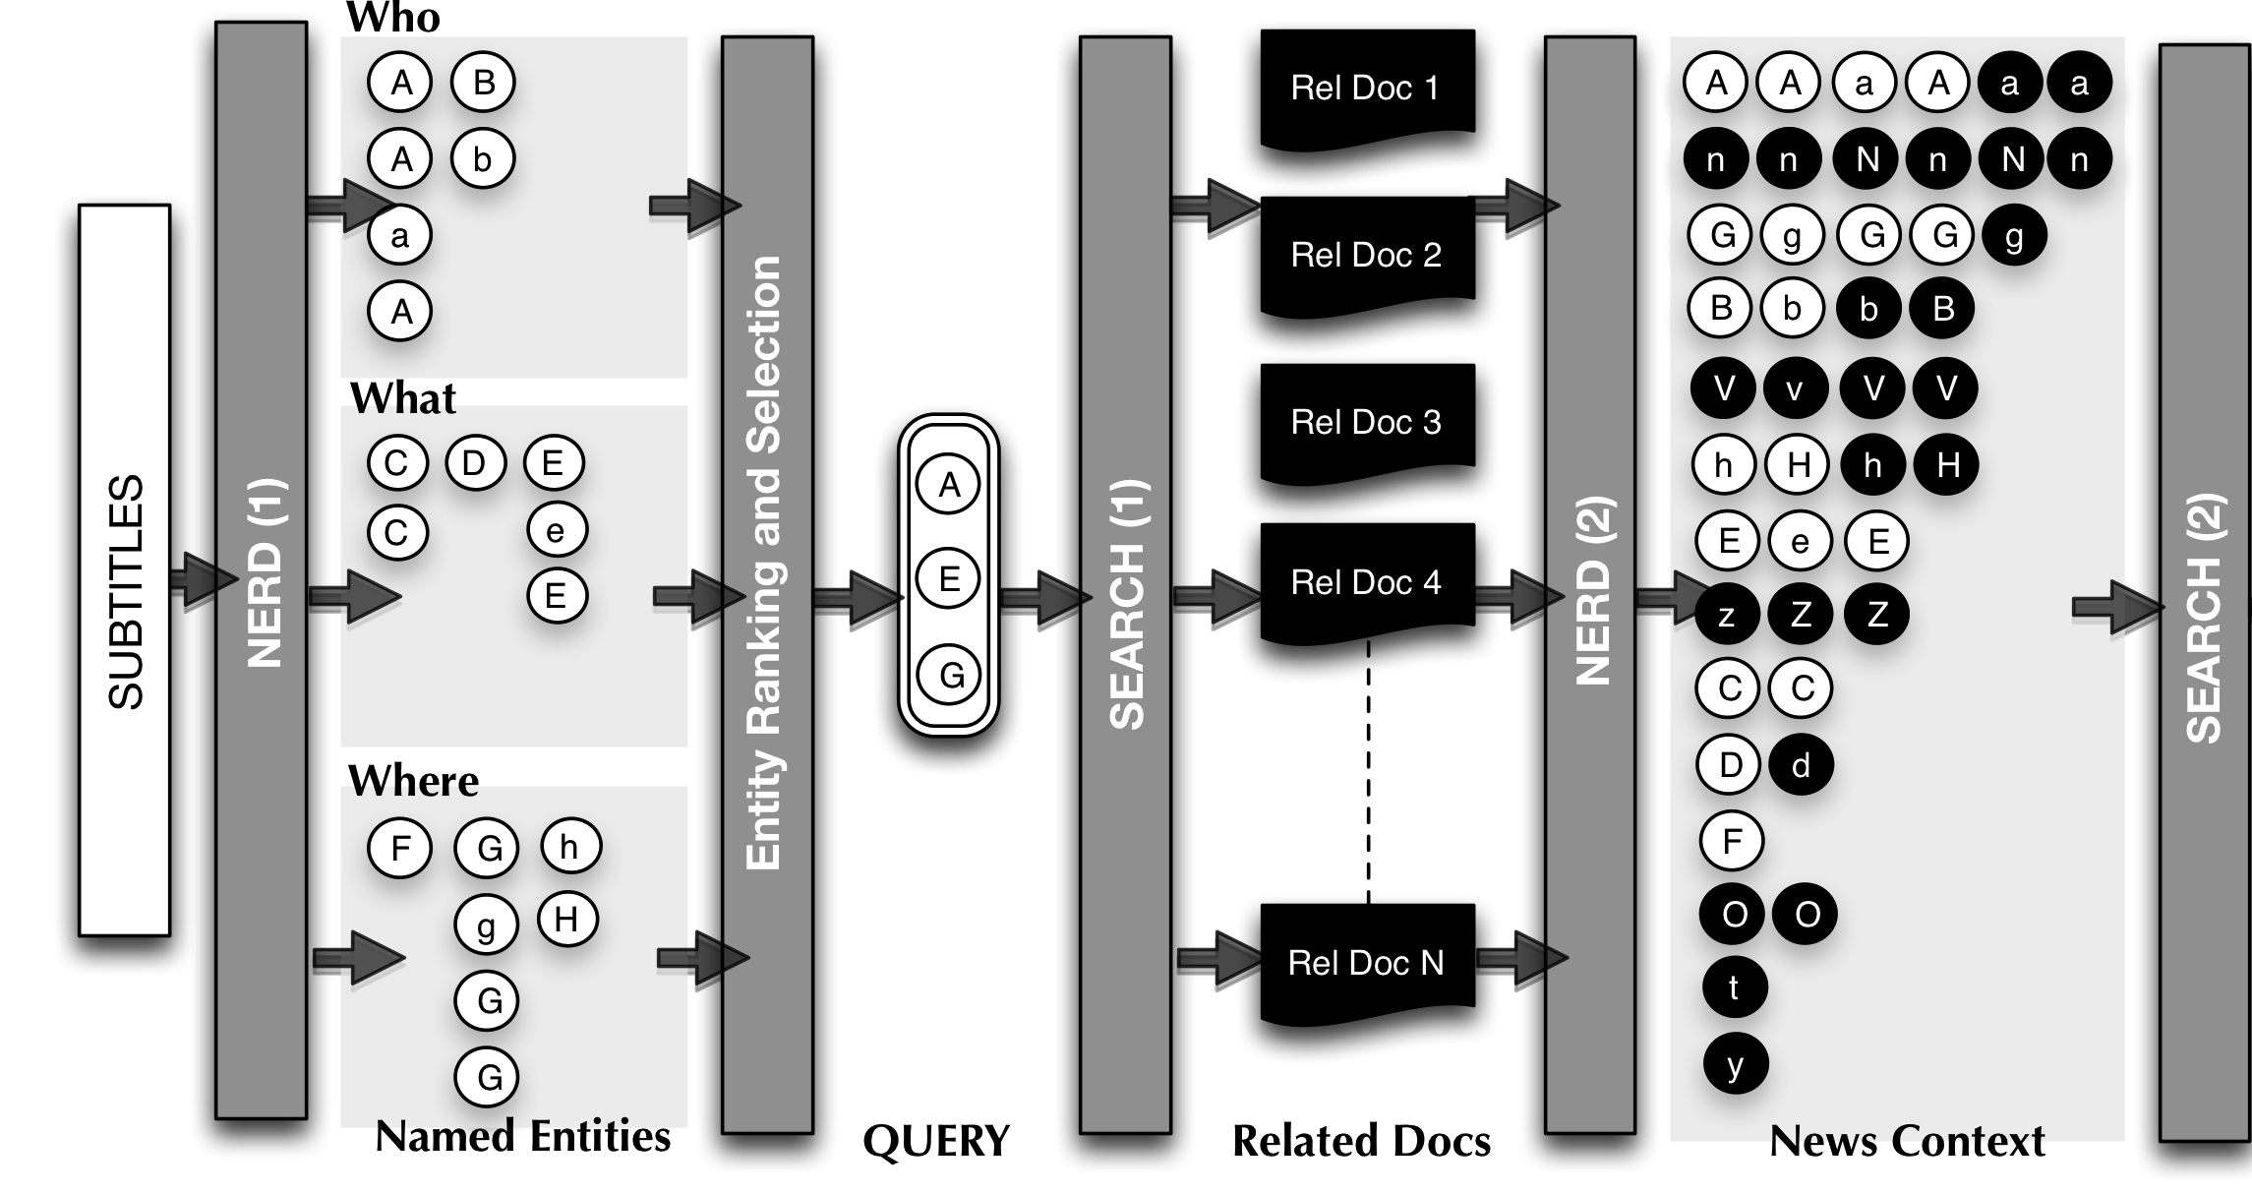
Named Entity Expansion
5

Slide 6
















Named Entity Expansion
ontology¹
REST API²
UI³
¹ http://nerd.eurecom.fr/ontology
² http://nerd.eurecom.fr/api/application.wadl
³ http://nerd.eurecom.fr
6

Slide 7
Named Entity Expansion
Five W´s * ➔ Four W´s
Who?: nerd:Person, nerd:Organization
What?: nerd:Event, nerd:Function, nerd:Product
Where?: nerd:Location
When?: from Newscast’s metadata
Entity Ranking and Selection:
Ranking according Extractor’s Relevance
Relative Relevance falls in the upper quarter interval
Final Query:
Concatenate Labels of the selected entities in Who, What, Where, for a time t
(*) J. Li and L. Fei-Fei. What, where and who? classifying events by scene and object recognition.
7

Slide 8

Named Entity Expansion
Query
8

Slide 9
Named Entity Expansion
Entity Clustering:
Centroid-based approach.
Distance metric:
Strict string similarity over the URL’s
Jaro-Winkler string distance over labels.
Entity Re-ranking according to:
Relative frequency in the transcripts
Relative frequency over the additional documents
Average relevance from extractors
Outcome:
Frequent entities are promoted
Not disambiguated Entities can obtain a URL by transitivity
Same happens with erroneous labels
Relevant but non spotted entities arise (Example: N)
9

Slide 10
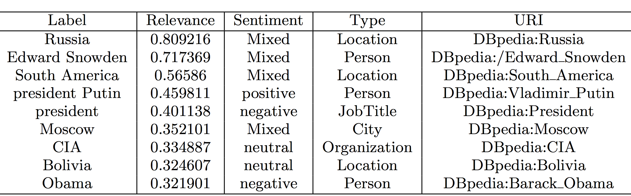
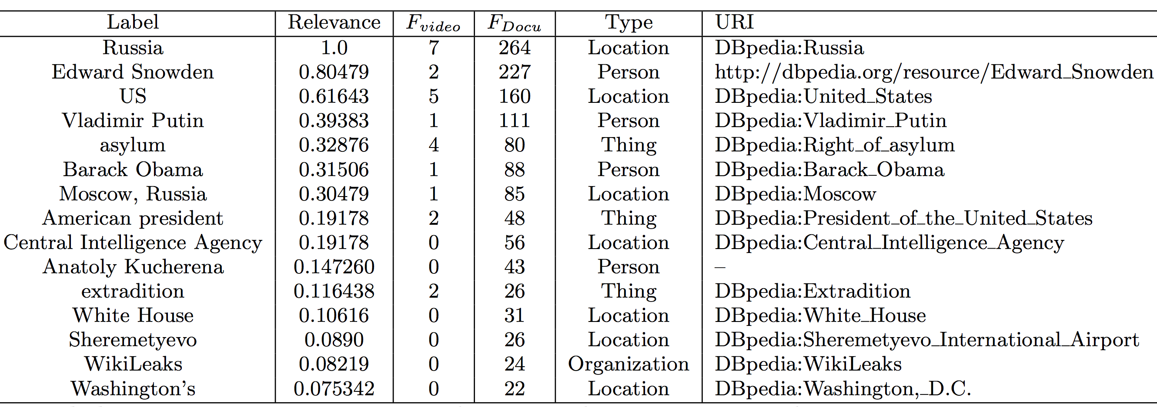
Named Entity Expansion: Results
Named Entity Expansion
10
Notes:
REMINDER: Labels are better after the expansion, for example: Vladimir Putin

Slide 11

Refining via EiCE
..
11

Slide 12
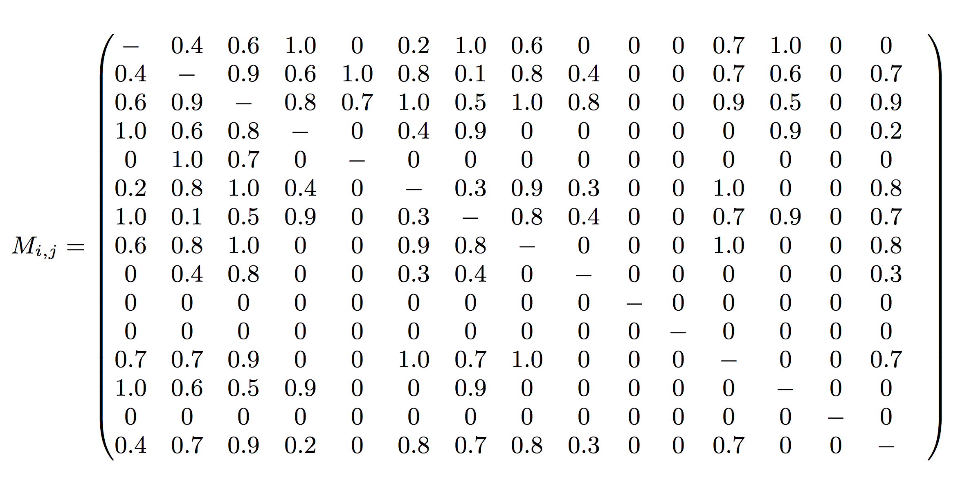
Refining via EiCE: Adjacency Matrix
..
Context Coherence
Wikileaks
Kucherena
Sheremetyevo
Adjacency Matrix M_{i,j}
D(e_{i} ,e_{j}) =Avg(lenght(Paths(e_{i}, e_{j} ))))
12

Slide 13
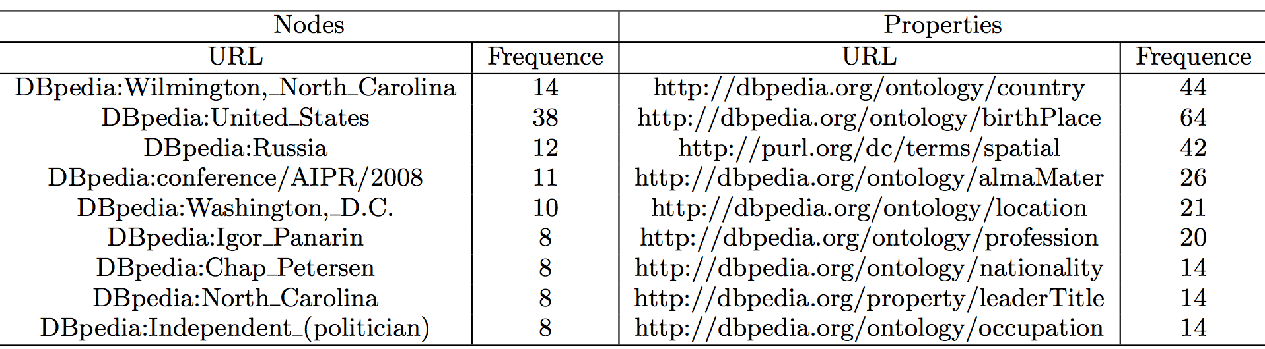
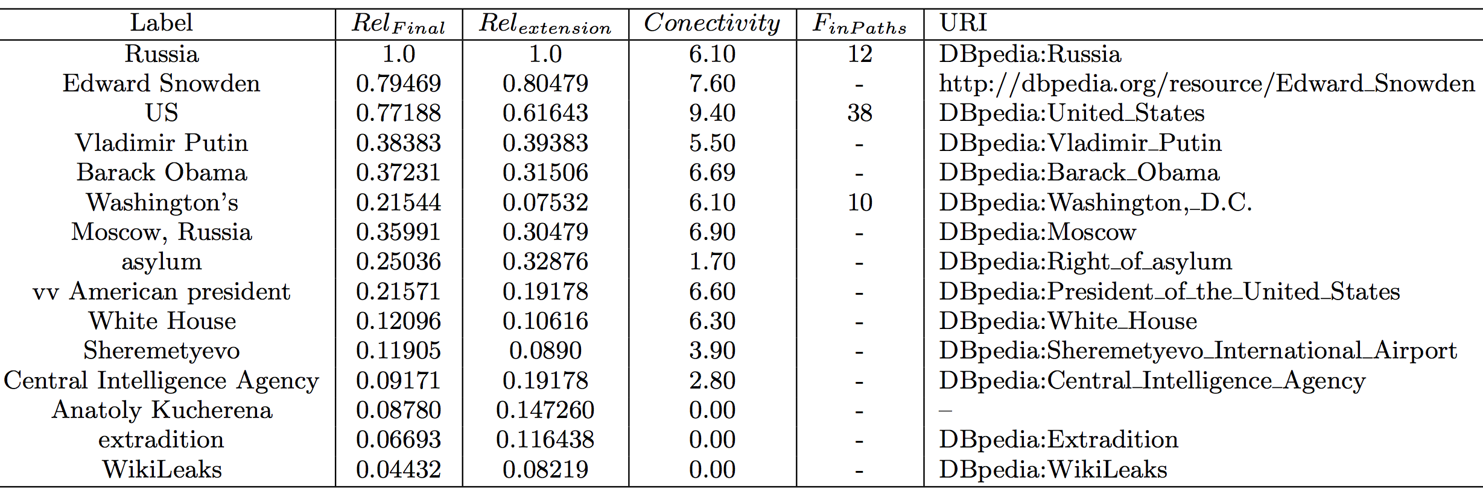
Refining via EiCE: Results
..
Frequent Nodes and Properties
Geographical and political matters!!
Final Context Entities
13

Slide 14
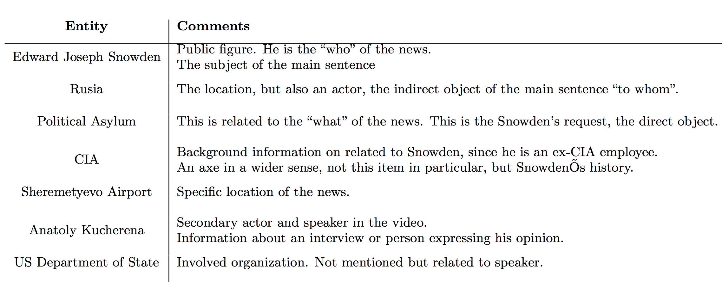
Evaluation: Edward Snowden Asylum
..
Set up of the Experiment
✔
✔
✔
✔
✔
✔
✔
Compare with the three phases
All entities proposed by the Expert were automatically obtained
From Named Entity Expansion:
New entities: Asylum, Anatoly Kucherena, Sheremetyevo.
Others such as human-rights and extradition help to complete the context of the news.
From DBpedia clues:
Entities like “Sheremetyevo” are now scored higher.
Detects other relevant like prime Minister of Russia, Igor Shuvalov.
14

Slide 15
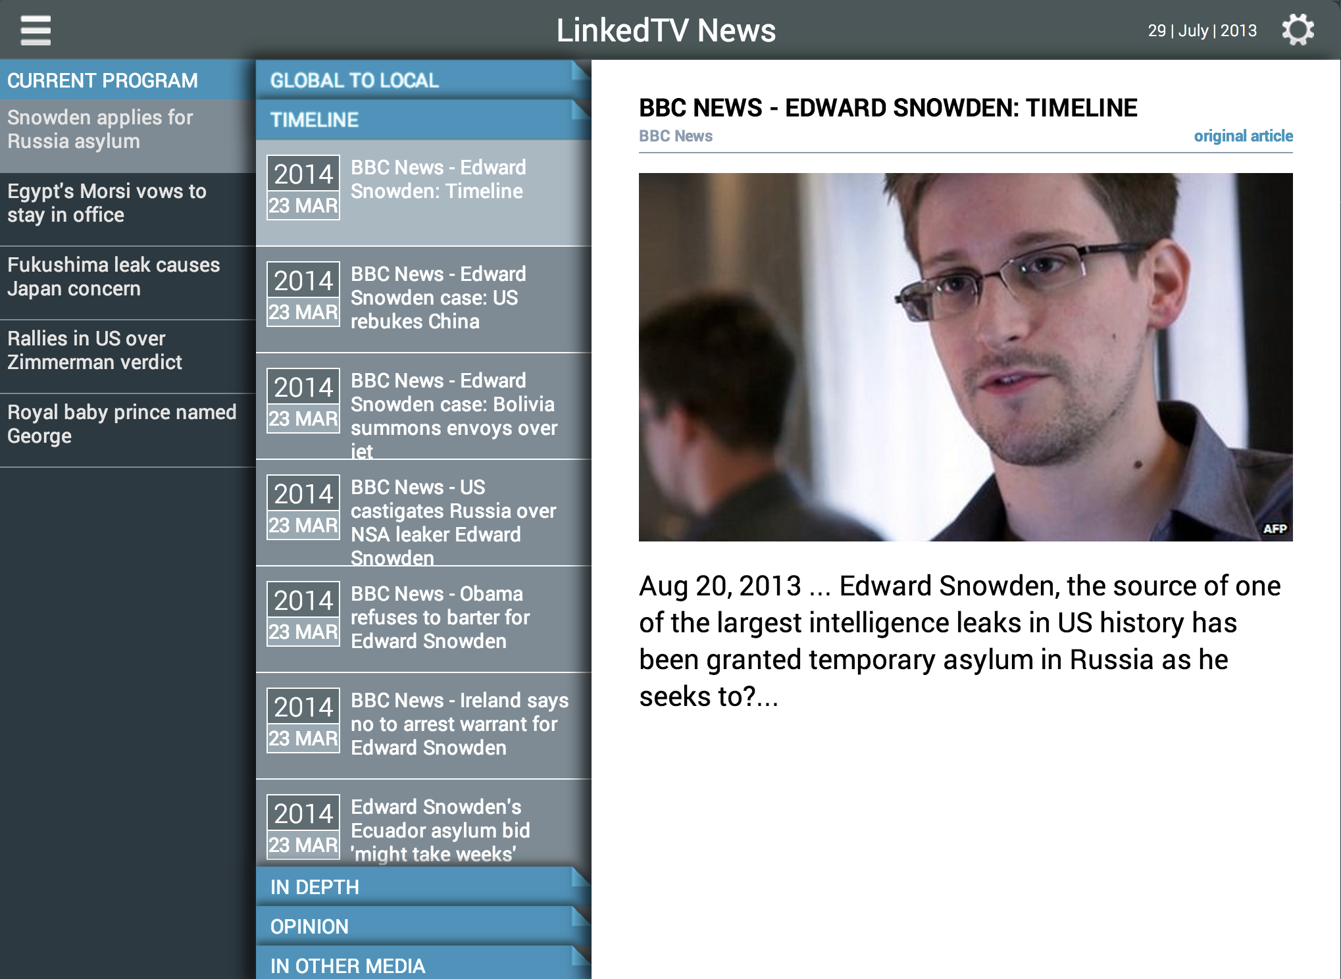
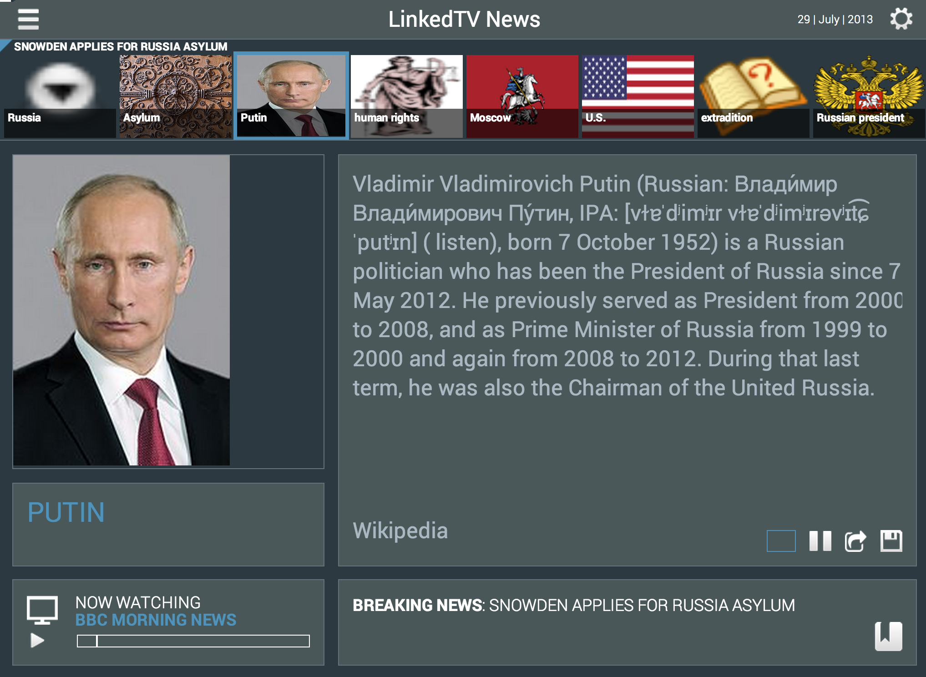
Feeding a companion TV app
Main Screen @
http://linkedtv.project.cwi.nl/news/mainscreen.html
Second Screen @
http://linkedtv.project.cwi.nl/news/
15

Slide 16
Conclusions
We presented an approach for context-aware annotating News Events:
Starts from named entities recognized in timed text
Expands this set by analyzing additional documents about the same event.
Completes with cues about the path connectivity in DBpedia.
Preliminary results indicate that:
The initial set of entities is augmented with relevant concepts not detected by pure NE approaches
By exploring DBpedia paths we:
Obtain a more accurate ranking of the relevant concepts
Bring forward more related entities.
Filter out those that are not representative in the broader context of an event.
Companion Application

Slide 17
Future

Slide 18
Contextualizing Events in TV News Shows
José Luis Redondo García, Laurens De Vocht, Raphaël Troncy,
Erik Mannens, Rik Van de Walle
{redondo, raphael.troncy}@eurecom.fr
{laurens.devocht, erik.mannens, rik.vandewalle}@ugent.be

